Slide 1



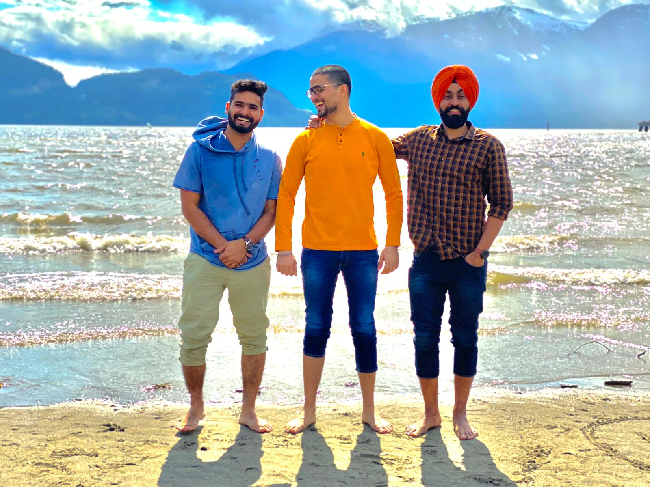
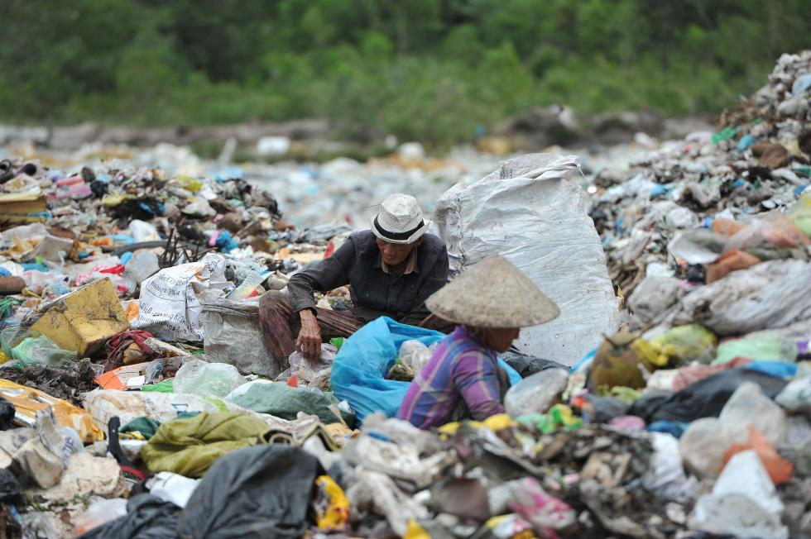
Plastic Consumption and It’s management in Vietnam
FALCON-V
Manoj Kumar
Vasu Chouhan
Arshpreet Singh
Aditi Jaswal
Vivek Reddy

Slide 2
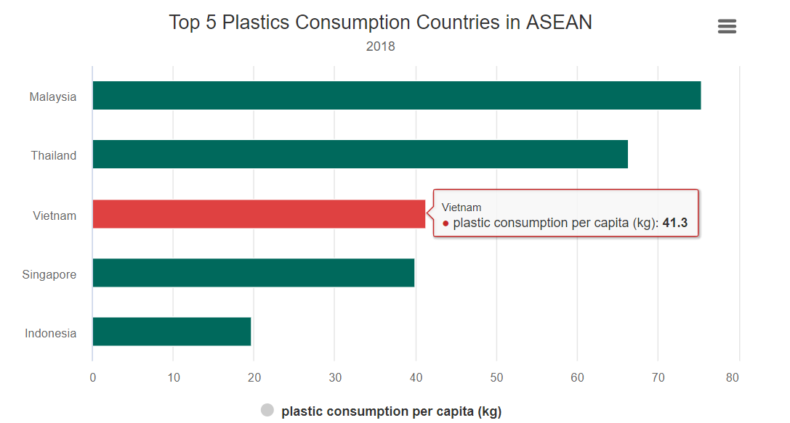
Introduction
Did you know, Vietnam – a beautiful southeast Asian country on Indochinese peninsula with a total area of 331,210 square km known for its beautiful beaches, museums and as one of the largest exporters of electronics, textiles, wooden products, seafood, steel, crude oil, pepper, rice and coffee in the world is currently struggling to manage it’s plastic waste?
Sources state that Vietnam discharges between 28-75 million tons of plastic waste yearly which is 6% of total worldwide volume.
The consumption of plastic per capita in Vietnam has enormously increased from 3.8 kg per person in 1990 to 41.3 kg per person in 2018. This plastic waste is not been properly managed and is introduces to cities, seas, beaches, rice fields and thus causing serious environmental threats.
It is serious not only for Vietnam but for the whole world and the environment.
https://e.vnexpress.net/news/news/vietnam-plastic-waste-problem-goes-from-bad-to-worse-3978124.html
Notes:
Insert a map of your country.

Slide 3



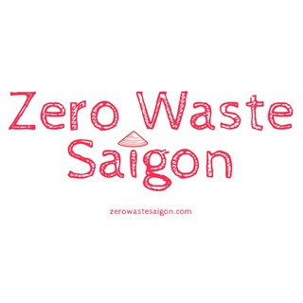
How Is Vietnam managing plastic waste?
Problem of increasing plastic waste has led to launch of number of campaigns and environmental projects.
CHANGE VN: A local NGO, works on community communication and changing people’s attitude towards environment and enlightening them by organizing campaigns.
Cleanup Vietnam: This organization engages youth, business communities and families to clean up plastic and other waste from beaches and surroundings.
Zero Waste: Zero waste is an organization that sells eco-friendly products online and encourages people to discard plastic by providing alternative solutions.
No Straw Challenge: Youth of Vietnam have led an initiative to say no to straws and launched NoStrawChallege in order to alleviate its potential threats imposed on environment.
Source:https://blisssaigon.com/vietnam-starts-to-fight-back-on-plastic-pollution/
Notes:
Insert a picture of one of the geographic features of your country.

Slide 4
Plastic consumption: Consumer’s attitude Survey AND ANAlysis
This survey had 7 sections from A to G. Section A - Knowledge Section B - Attitude and Perception Section C - Social norms Section D - Perceived behavior control Section E - Plastic - related behaviors Section F - Intentions to change behaviors Section G - Communications related to plastics
Notes:
Insert a picture illustrating a season in your country.

Slide 5

What we Aim with this information?
At first, we aim to study the given data well and find out meaningful insights in order to understand the problem and provide possible solutions. We check all the survey questions against each and every demographic information like gender, income, education etc. provided in the dataset.
Objectives:
• To know about the trend of awareness about the environmental impacts of
plastics among different genders and educational groups and occupations.
• How the general knowledge of plastic varies with genders and education.
• How public participation and environmental education are related.
• Awareness of plastic waste disposal and management.
• What can be the future measures to reduce plastic wastes?

Slide 6
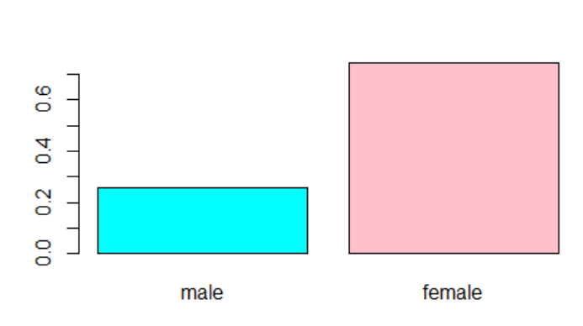
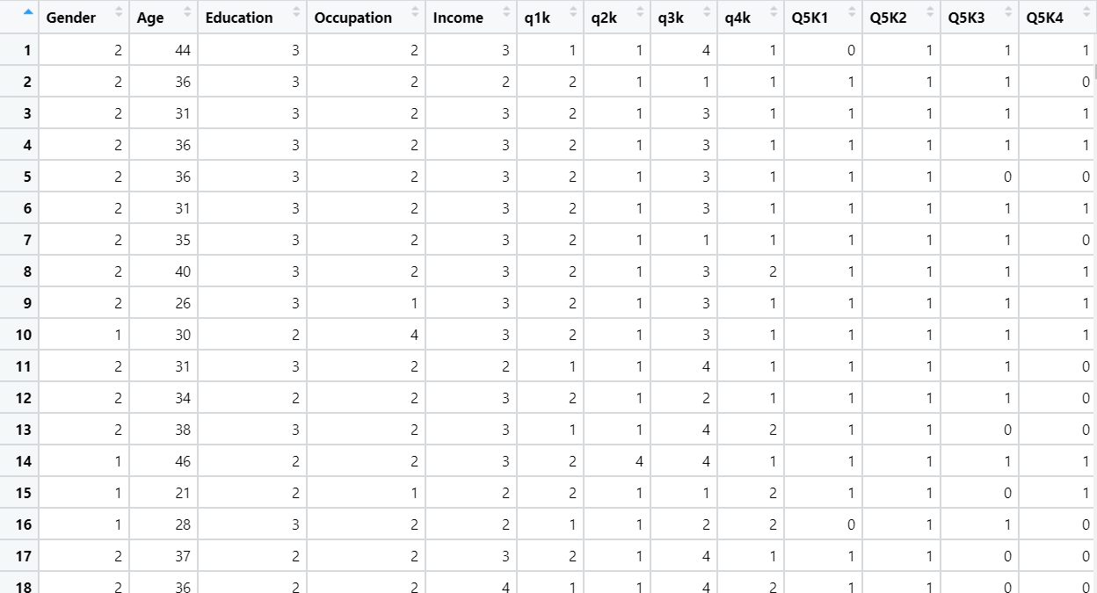
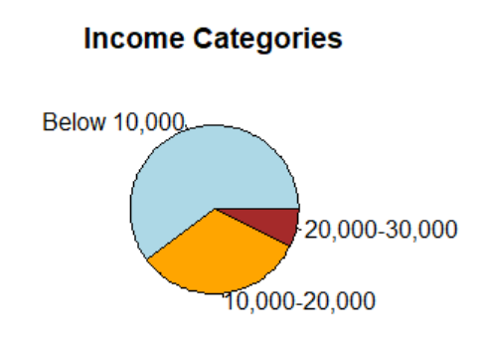
Descriptive Analysis
In descriptive statistics, basic features of the data are described through simple graphs in order to provide summaries about the variables.

Slide 7

Important IN-sights
64% males know that and 47% of females are aware that conventional plastic comes from fossil fuels. 94% males and 97% females know plastic straw is a one-time use plastic item that causes plastic pollution. 36% of males and only 9% of females know that 7 types of plastic exists. 70% people who took survey know plastic has adverse effects on human health while 80% are aware of environmental consequences. Approx. 50% of both gender groups, know that most of the plastic waste is dumped at landfill sites and as litter to the environment. Females tend to be more aware of the fact Vietnam being one of the top 5 contributors of mismanaged plastic waste (almost 6% of mismanaged plastic of the world).
Notes:
Add key points in the history of your country to the timeline.

Slide 8
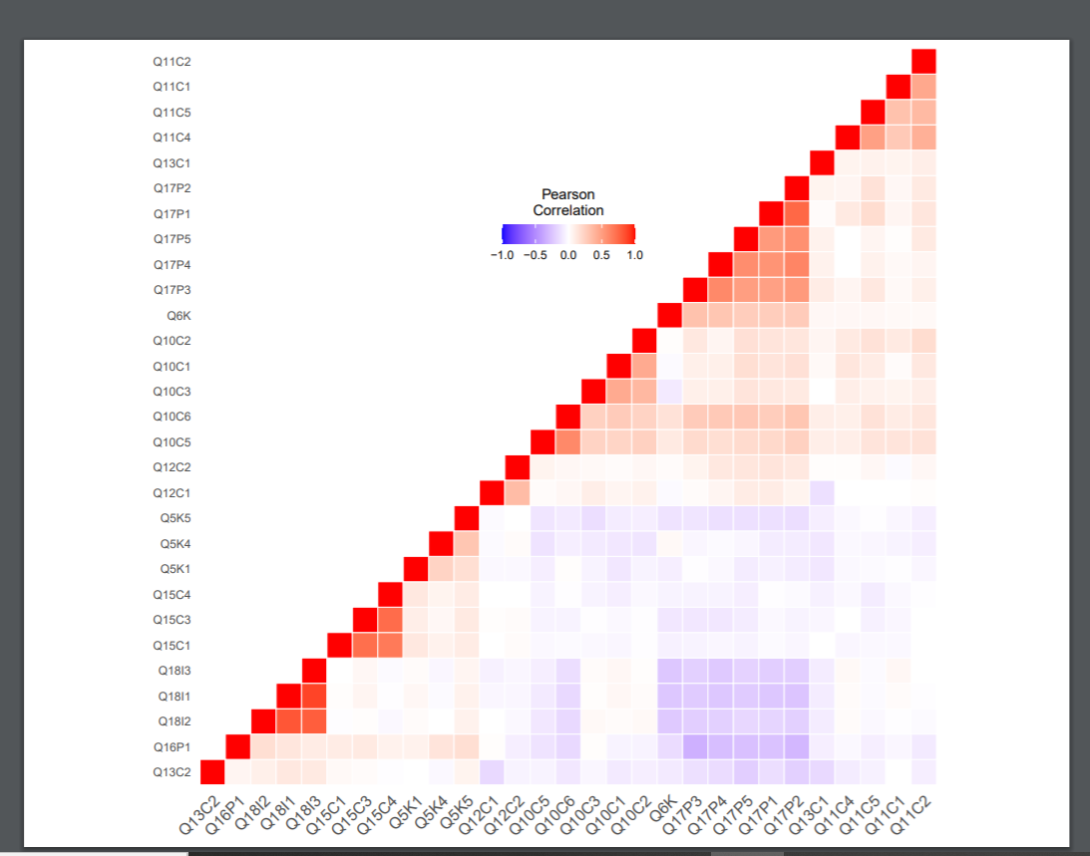
Correlation

Slide 9
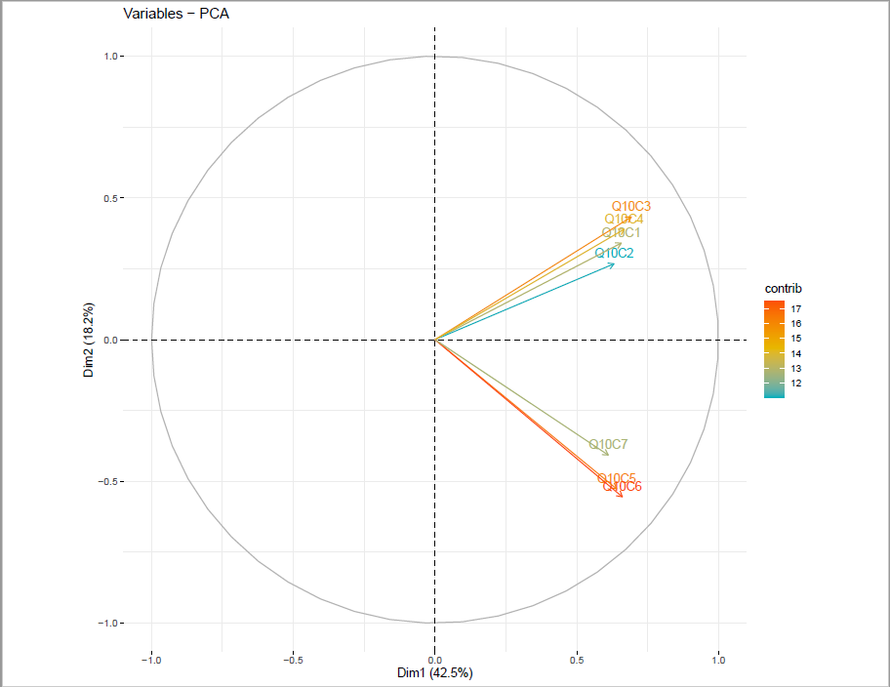
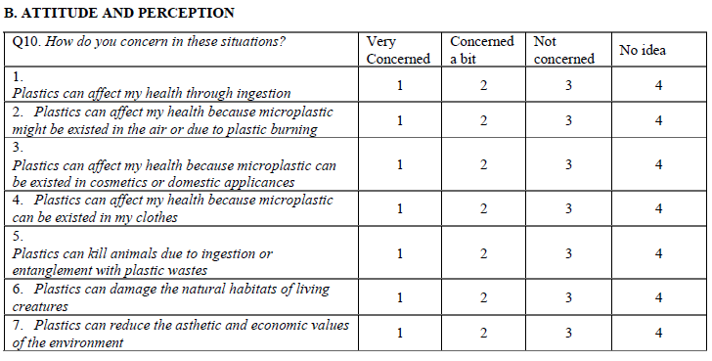
TECHNIQUES USED For inferential analysis
PCA

Slide 10

Our curiosity to know the effect of using MICE library on data, led to exploring the dataset in two ways.
First, we filled the null values by using MICE library; and
Second, we simply removed the null values.
The prime purpose of reducing the dimensions of dataset was achieved by performing Factor Analysis which we will discuss in next slides.

Slide 11
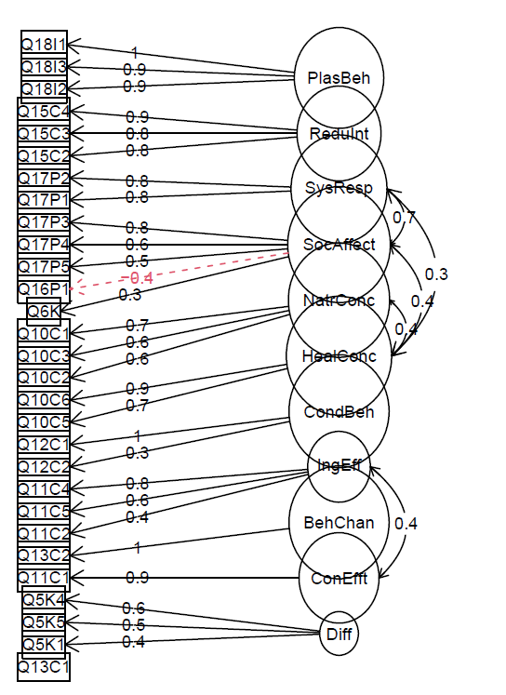
Factor Analysis With MICE
Factor Analysis After Applying MICE on Dataset with 11 Latent Variables
Attitude towards Nature
Attitude towards Health
Change in Behaviour
System responsibility

Slide 12
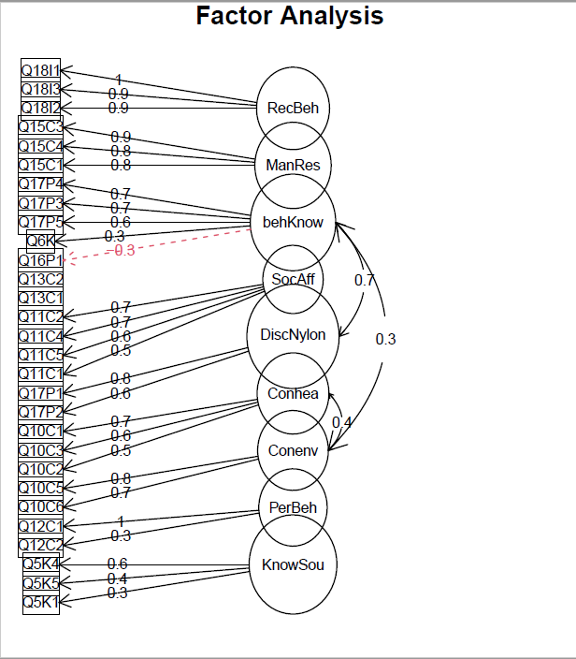
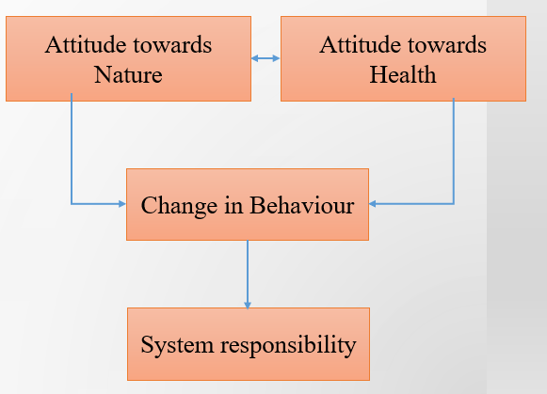
Factor analysis With MICE (FINAL)
Factor Analysis After Applying MICE on Dataset with 9 Latent Variables

Slide 13
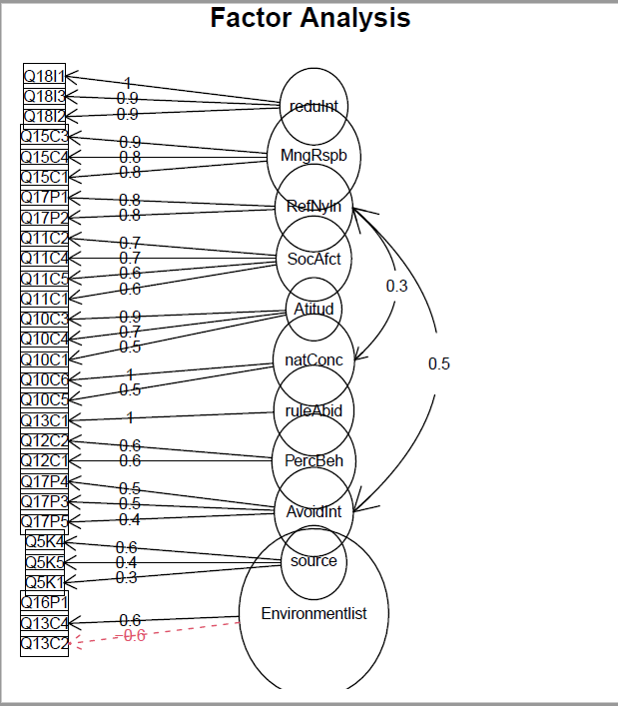
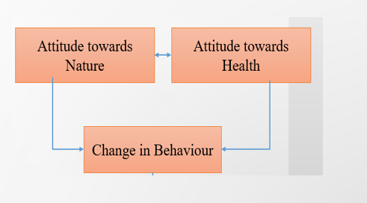
Factor Analysis Without MICE
Factor Analysis After Applying Without MICE on Dataset and with 11 Latent Variable

Slide 14
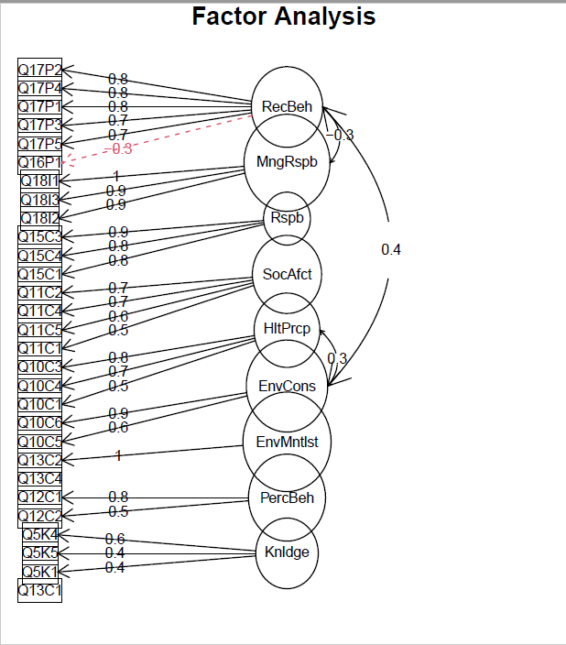
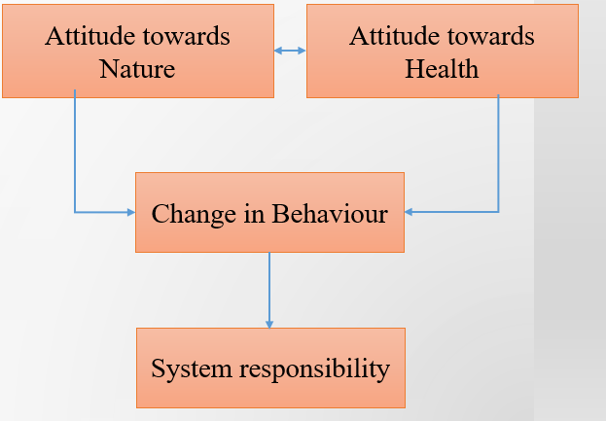
Factor Analysis Without MICE (FINAL)
Factor Analysis After Applying without MICE on Dataset with 9 Latent Variables

Slide 15
CHI-square Analysis:
There is no difference in males and females in terms of attitude and perceptions towards plastic usage but some difference exists in terms of intentions to change behaviour.
There is no difference exists between school passed, graduated and post-graduated in terms of social-norms affecting plastic change but some difference exists in terms of intentions to change behaviour.
There is no difference exists between students, white collar workers and others in terms of social-norms affecting plastic change but some difference exists in terms of intentions to change behaviour.

Slide 16
Conclusion
After our in-depth analysis and understanding of the data, we conclude the following points:
People who think government is accountable for plastic waste management, do not take charge to recycle any plastic themselves.
Plogging is an alternative that people would like to opt to get rid of plastic problems.
People who are health conscious, are more concerned to health issues because of plastic usage.
Notes:
Insert a picture of the head leader of your country.

Slide 17
Thank You!! Questions…
Notes:
Insert a picture of one of the points of interest for your country.

